Slide 1
How to sign up for a membership

Slide 2
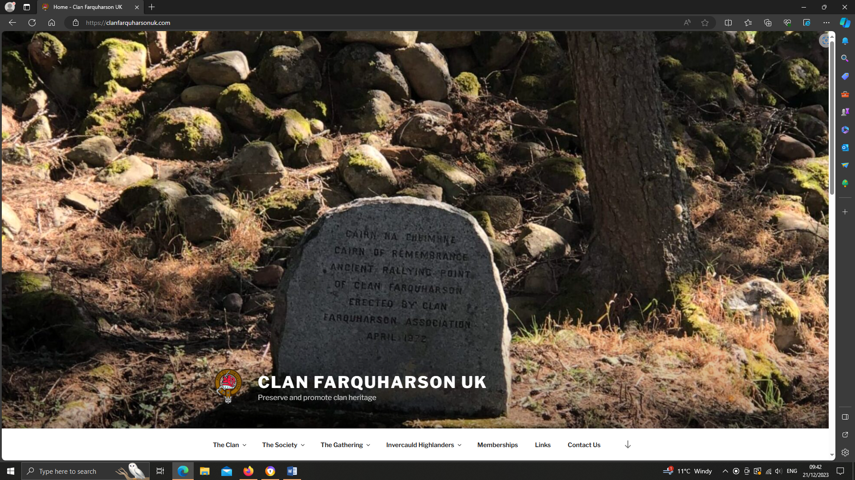
First step
Click on the “Memberships” menu item on the menu.

Slide 3
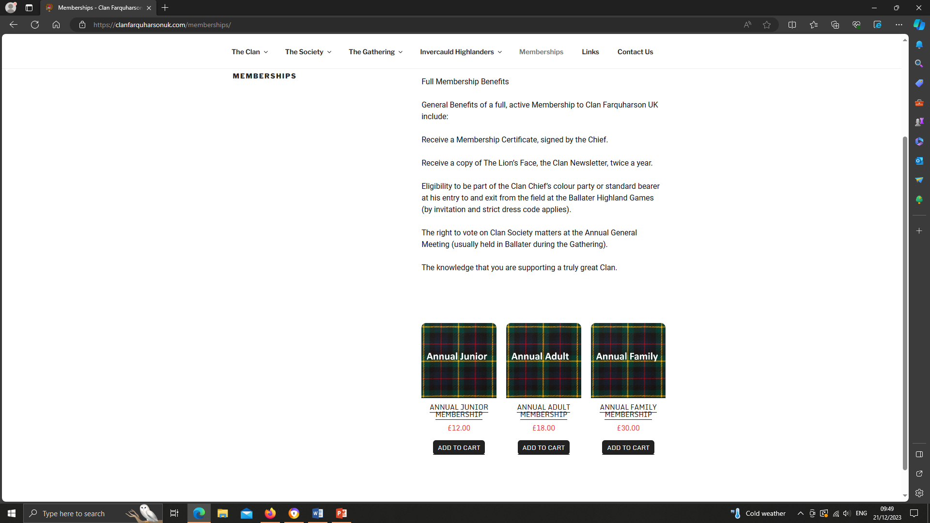
Next
Press the “Add to Cart” button under the type of membership you want.

Slide 4
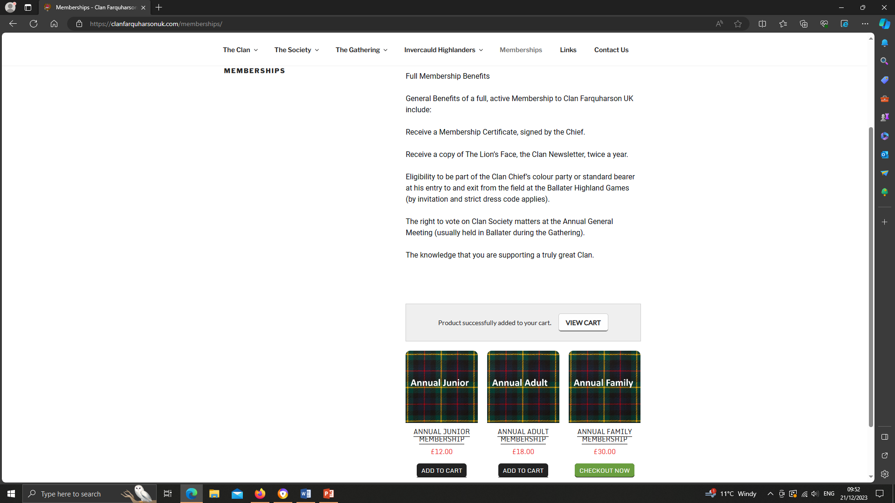
Next
If you are finished shopping, click the “Checkout Now” button.

Slide 5
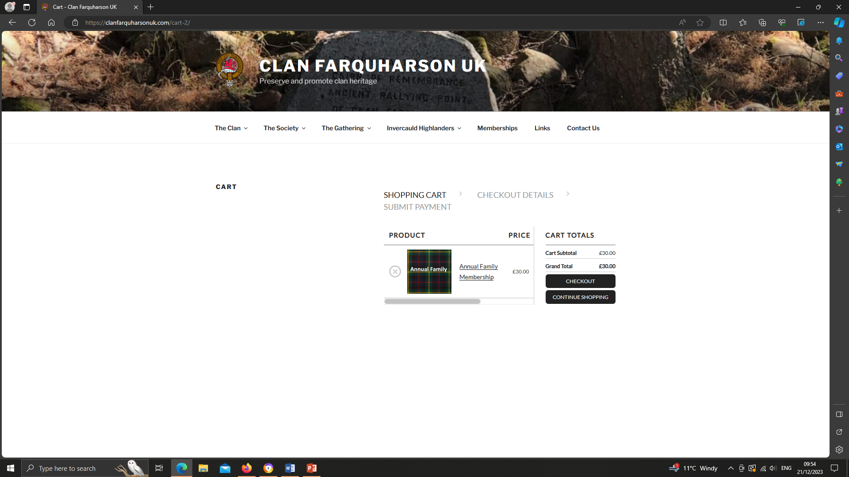
Next
Check and make sure you have the proper type of membership. If you do, click on the “Checkout” button.

Slide 6
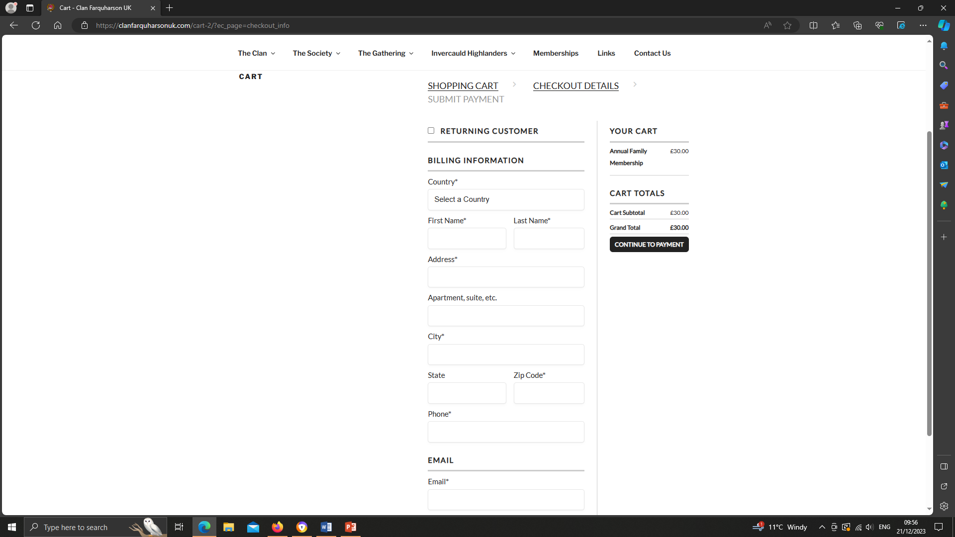
Next
Fill out all the information – your country, first and last name, address, phone number and email. Then click “Continue to Payment”

Slide 7
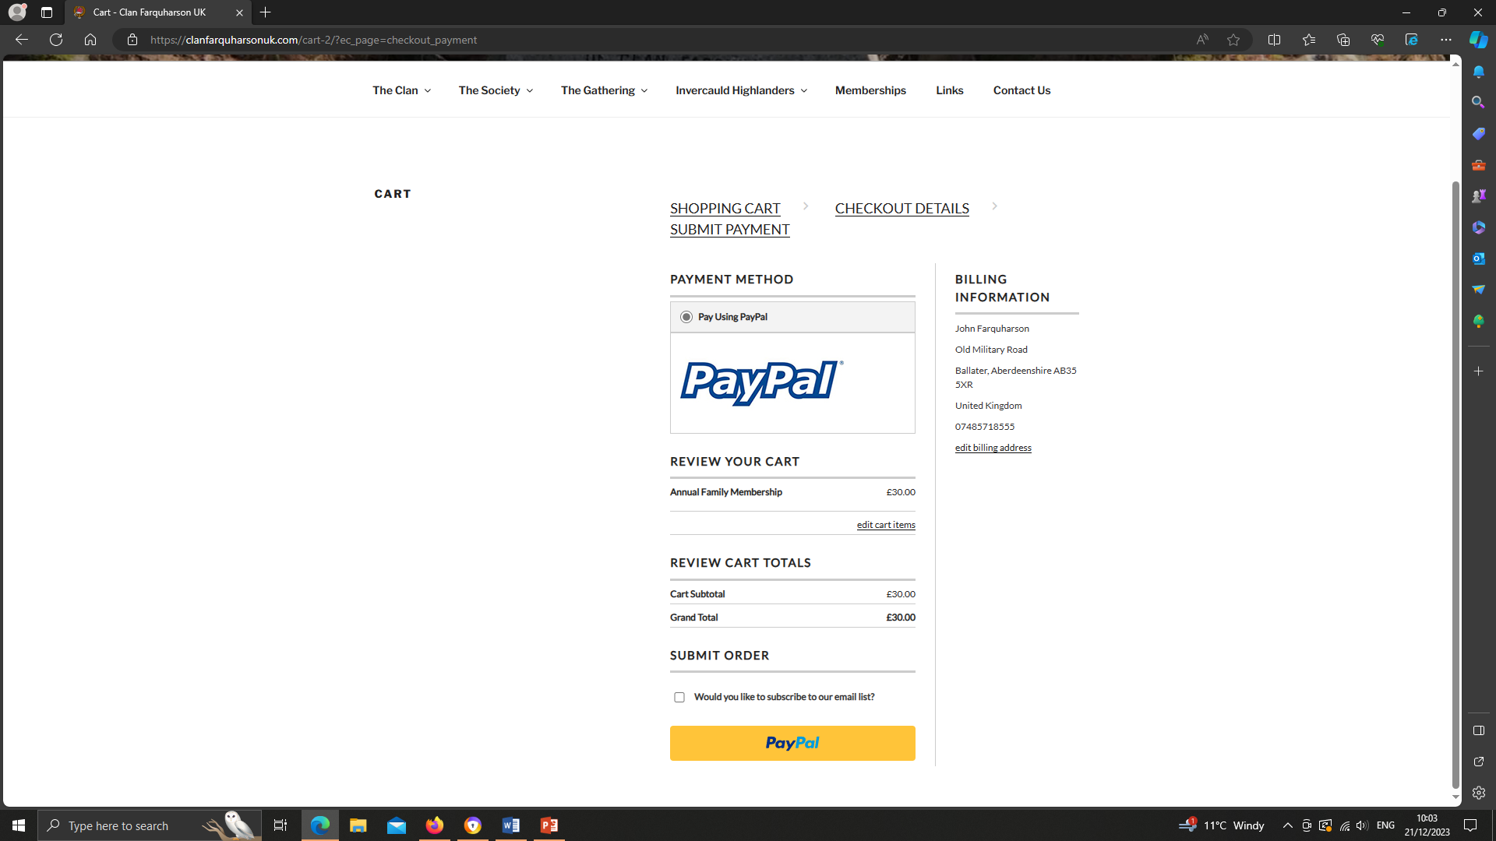
Next
Review the information to make sure it is correct and then click the “PayPal” button.

Slide 8
Congratulations!
Once you have completed the checkout process through PayPal, you will receive confirmation of your membership.
If you have any problems/questions about your membership, please send an email to Memberclanfarquharsonuk@gmail.com.
If you have any problems signing up, please send an email to webmgrclanfarquharsonuk@gmail.com

